Slide 1

Game of Thrones Script Analysis
Analysis is coming..
Kushal Thakkar
Rohan Khadilkar

Slide 2
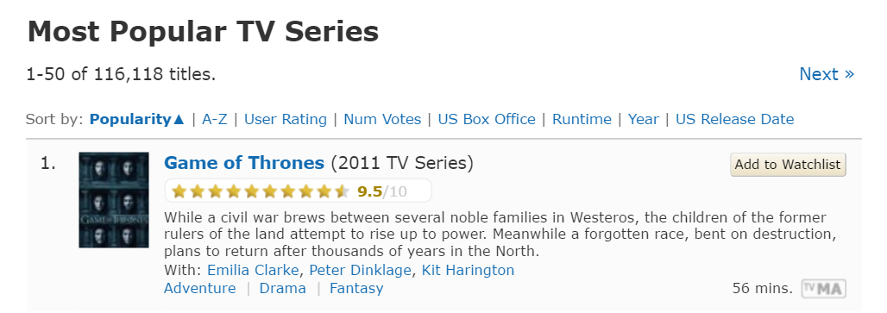
What is the secret to a successful TV Series?

Slide 3
It’s the script!

Slide 4
Methodology
Consolidating scripts of best movies and best GOT episodes.
“syuzhet” package in R
Normalization and sampling.
Smoothening techniques:
Moving Average
Fourier Transform

Slide 5
Script Analysis

Slide 6
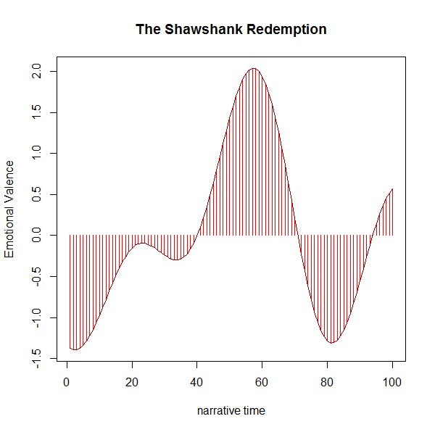
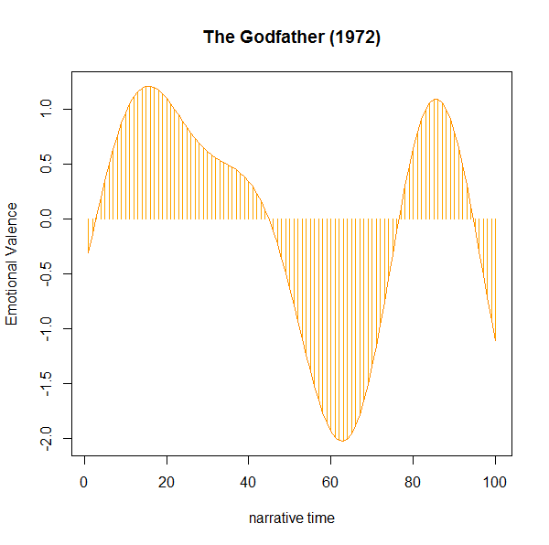
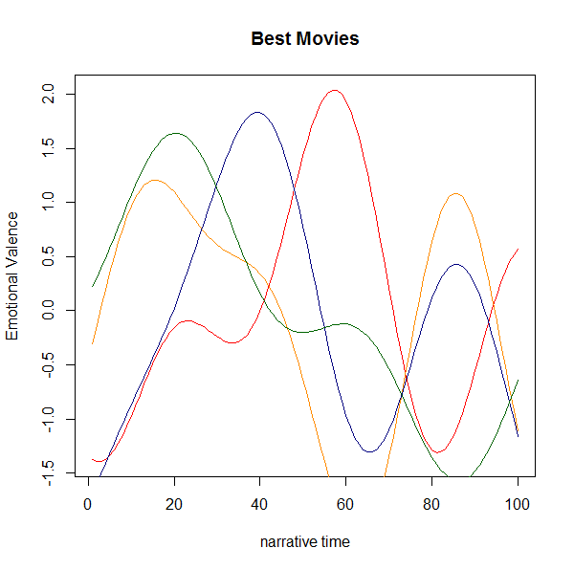
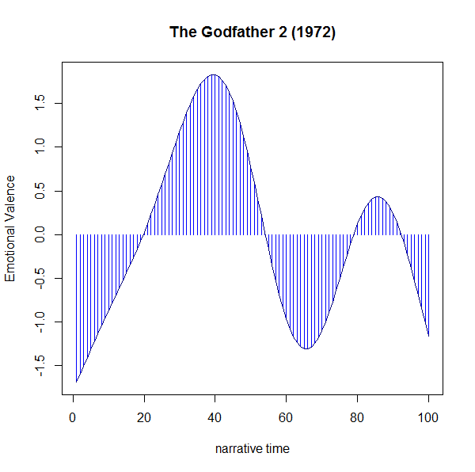
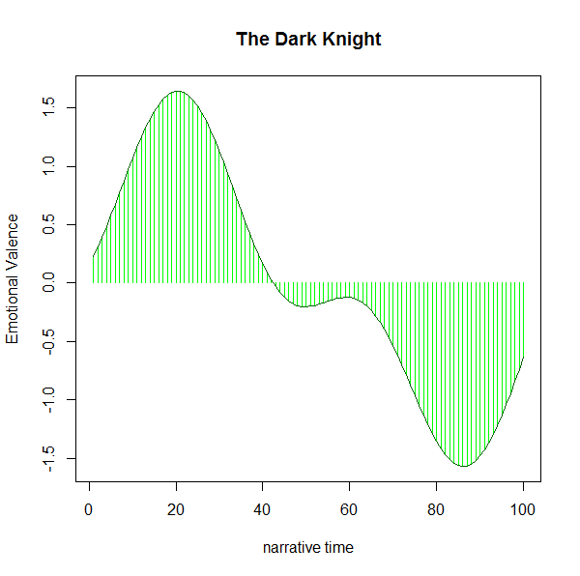

Slide 7
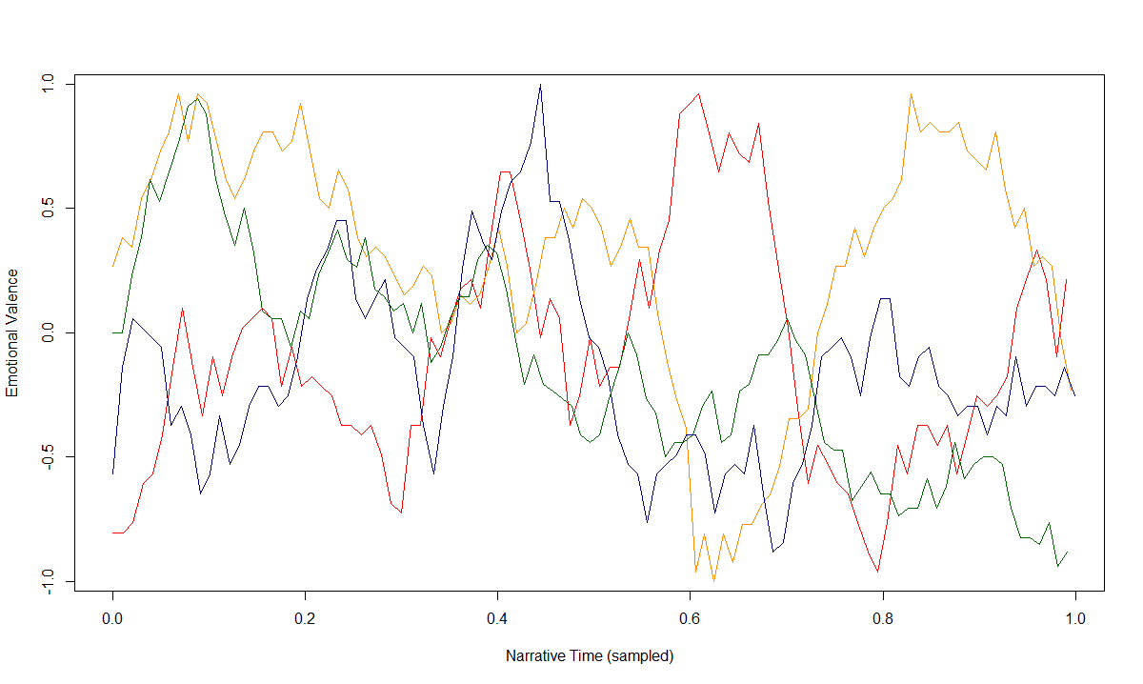
Best Movies: Moving Averaged and Sampled
Red: The Shawshank Redemption
Blue: The Godfather 2 (1974)
Yellow: The Godfather (1972)
Green: The Dark Knight

Slide 8
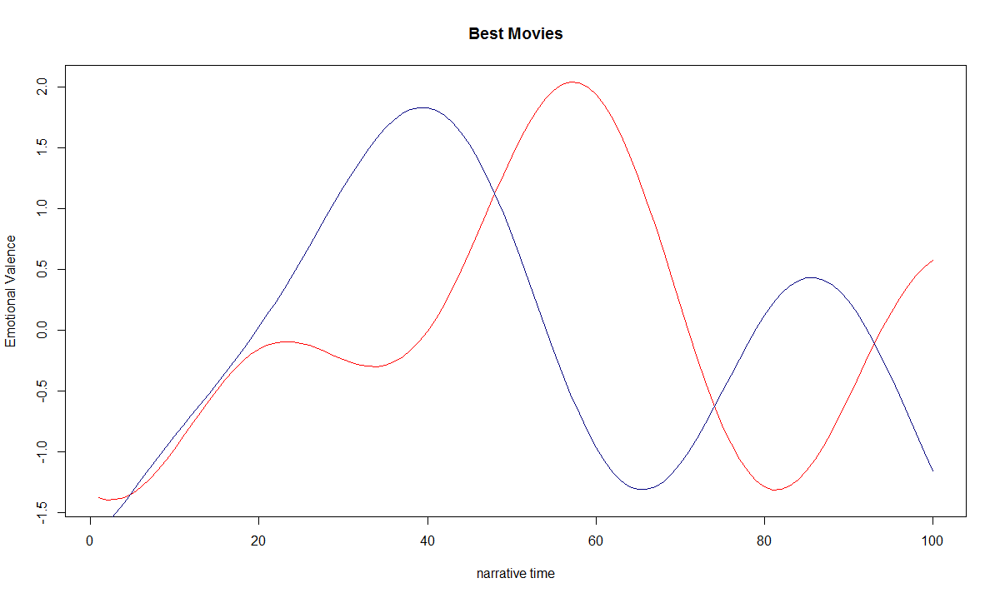
Red: The Shawshank Redemption
Blue: The Godfather 2 (1974)

Slide 9
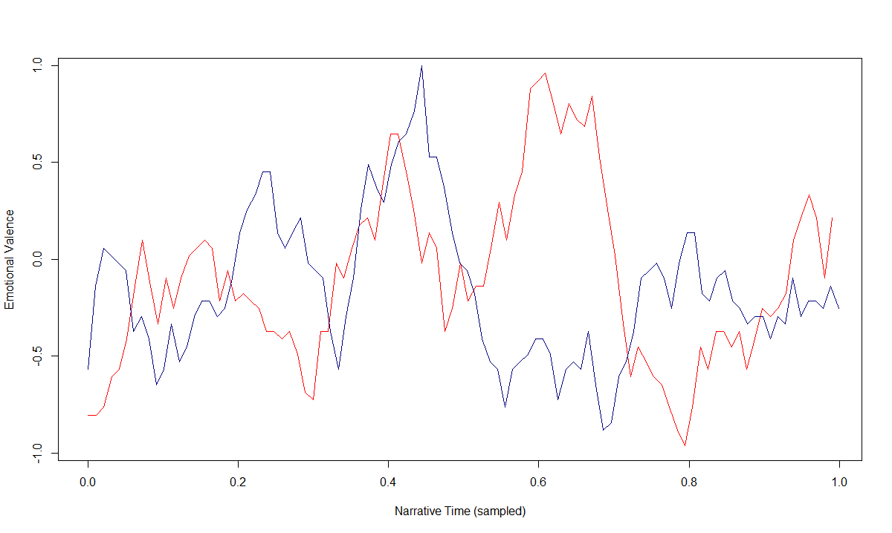
Blue: The Shawshank Redemption
Red: The Godfather 2 (1974)

Slide 10
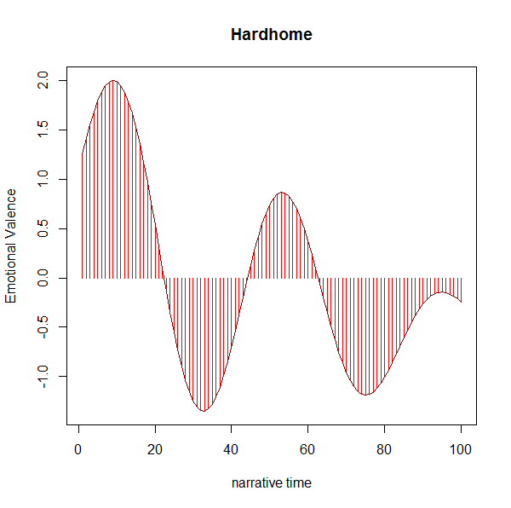
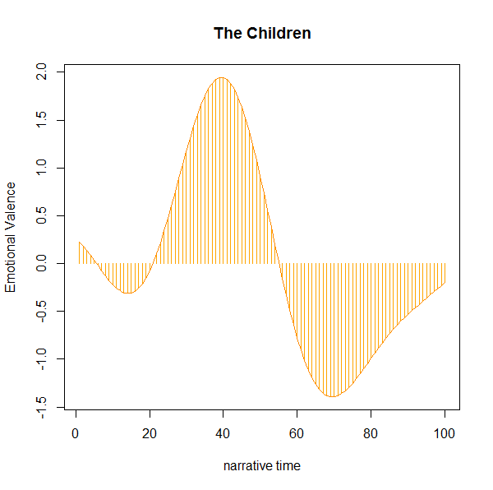
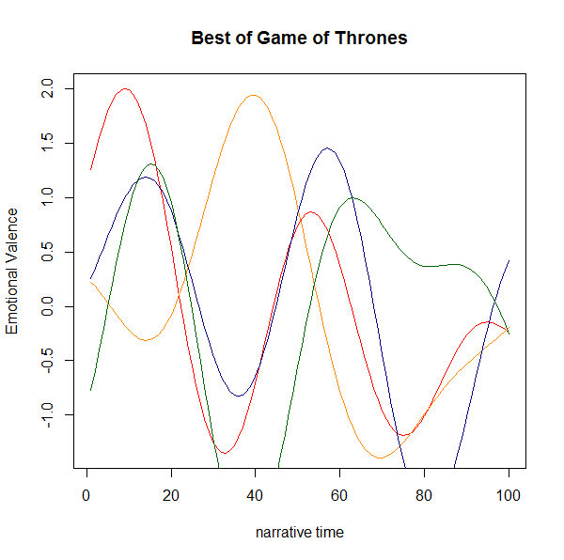
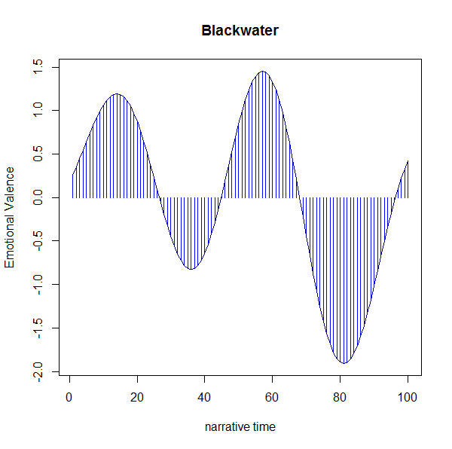
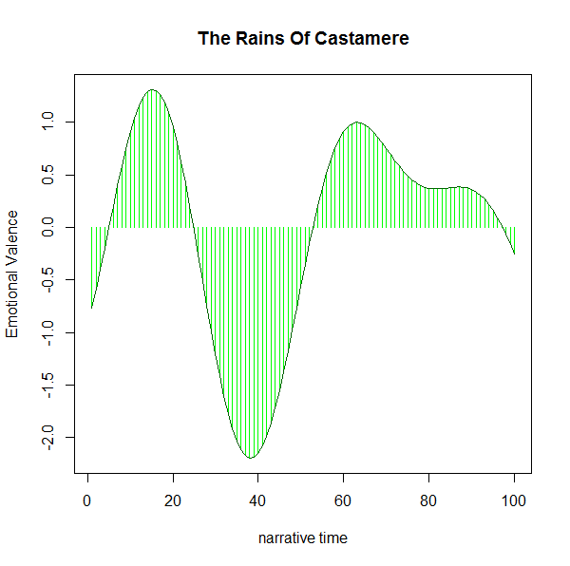

Slide 11
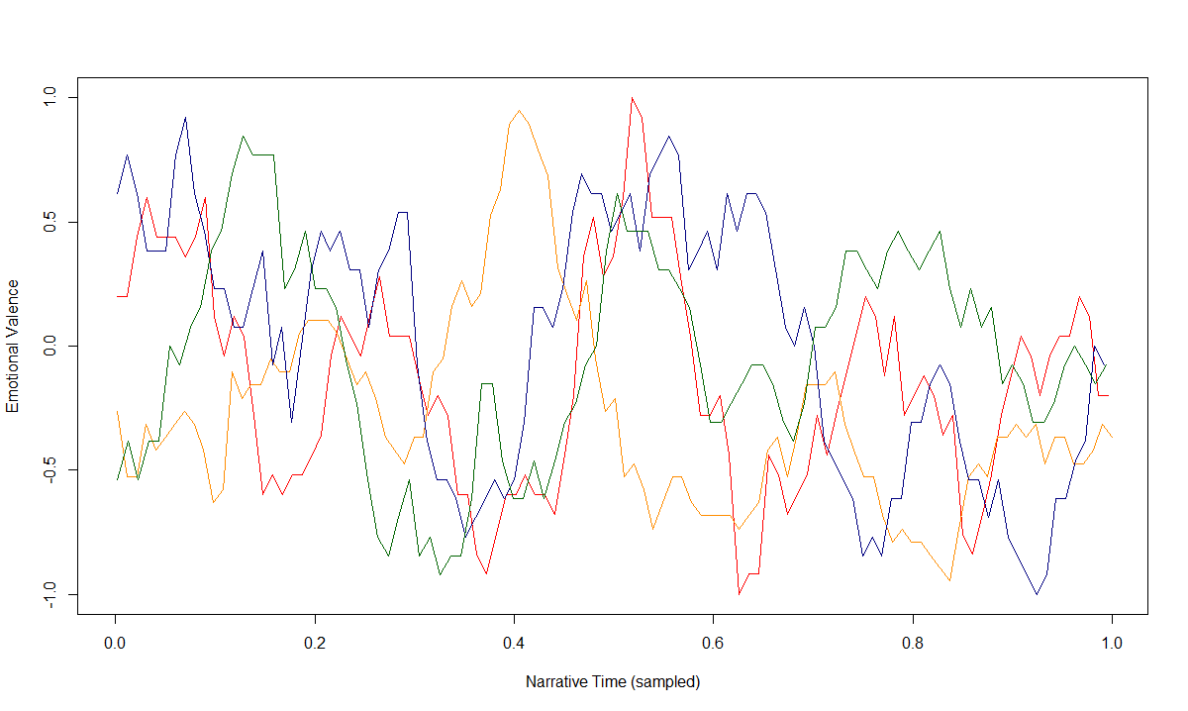
Best of GOT: Moving Averaged and Sampled
Red: Hardhome
Blue: Blackwater
Yellow: The Children
Green: The Rains Of Castamere

Slide 12
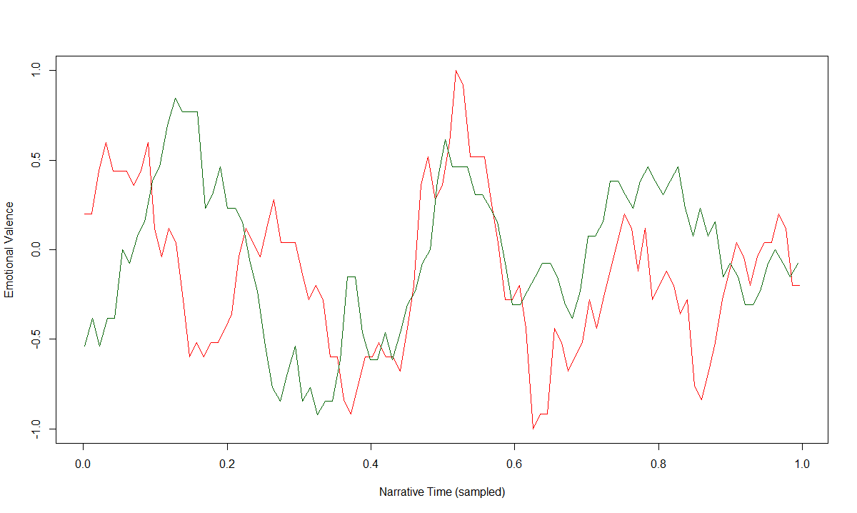
Red: Hardhome
Green: The Rains Of Castamere

Slide 13
Almost mirror image of each other

Slide 14
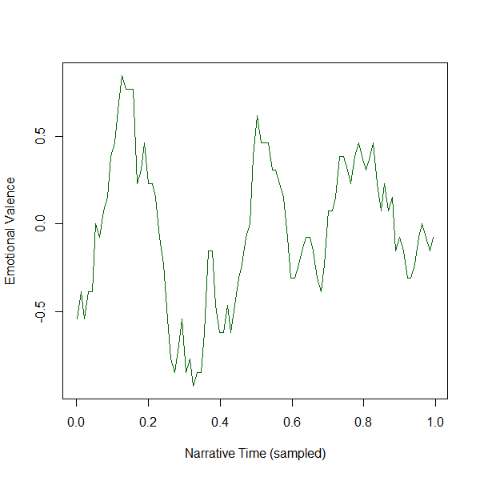
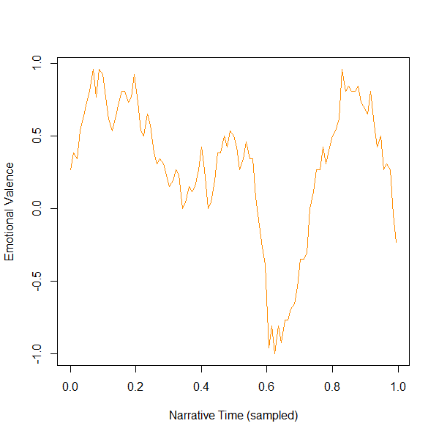
Green: The Rains Of Castamere
Yellow: The Godfather (1972)

Slide 15


Slide 16


Slide 17
Future Scope
Analyzing a complete TV Series
Map viewer sentiments with script analysis
Time as a factor
Storytelling
Script writing using data analysis

Slide 18
Conclusion
Want to make a successful TV Series/Movie? Hire a script writer first!
There’s a pattern to the storyline
TV show scripts may differ from movie scripts
Predicting the plot may be possible

Slide 19
References
Data
https://jordanschermer.wordpress.com/2014/08/06/valar-morghulis/
http://www.springfieldspringfield.co.uk/
Software
R
Tableau
Excel

Slide 20
Thank You.. Your Grace!

